Slide 1
EQ2401 Adaptive Signal Processing Project 2
Ziyue Yang Boyue Jiang
ziyuey@kth.se boyue@kth.se

Slide 2
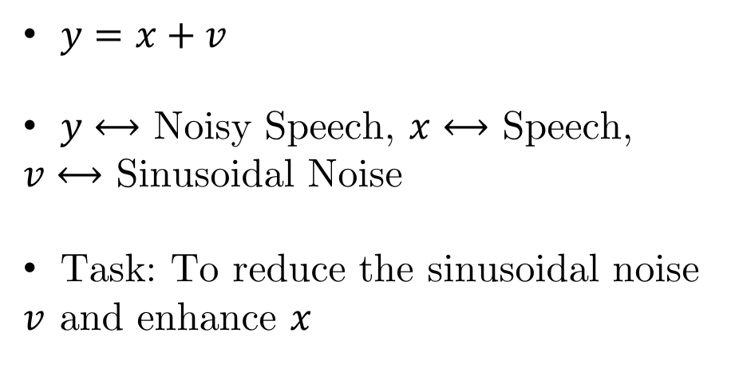
Project Description
$y=x+v$
$y⟷$ Noisy Speech, $x⟷$ Speech, $v⟷$ Sinusoidal Noise
Task: To reduce the sinusoidal noise $v$ and enhance $x$

Slide 3
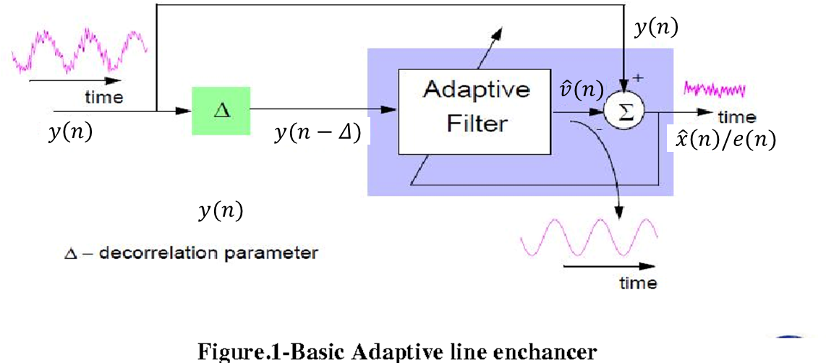
Adaptive Line Enhancer

Slide 4
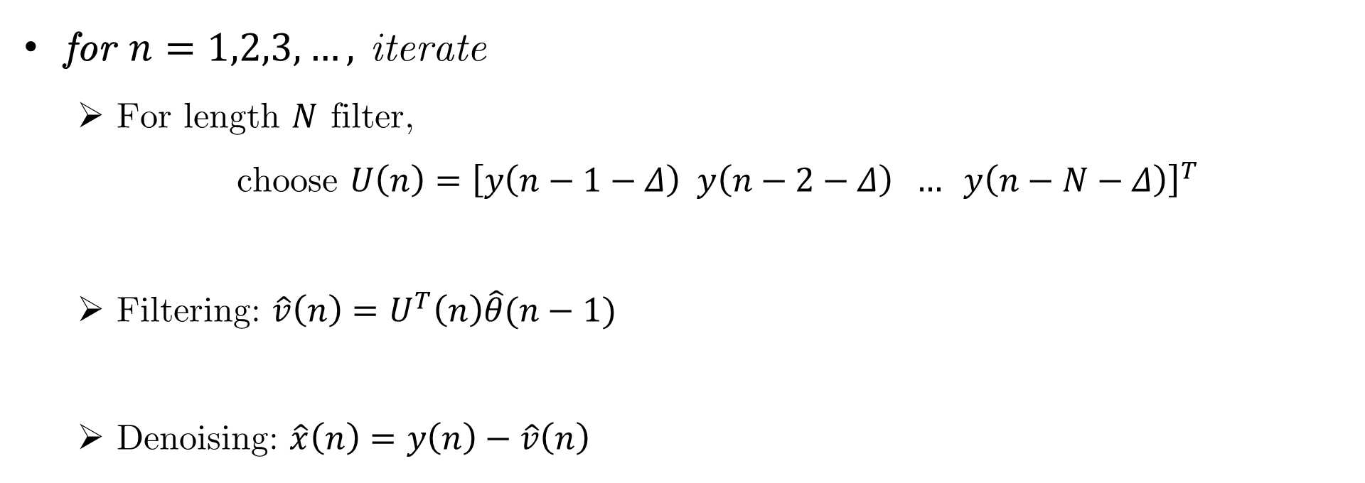
Adaptive Filtering
for $n=1,2,3,…,$ iterate
For length $N$ filter,
choose $U\left(n\right)={\left[y\left(n−1−Δ\right) y\left(n−2−Δ\right) … y\left(n−N−Δ\right)\right]}^{T}$
Filtering: $\hat{v}\left(n\right)=U^{T}\left(n\right)\hat{θ}(n−1)$
Denoising: $\hat{x}\left(n\right)=y\left(n\right)−\hat{v}\left(n\right)$

Slide 5
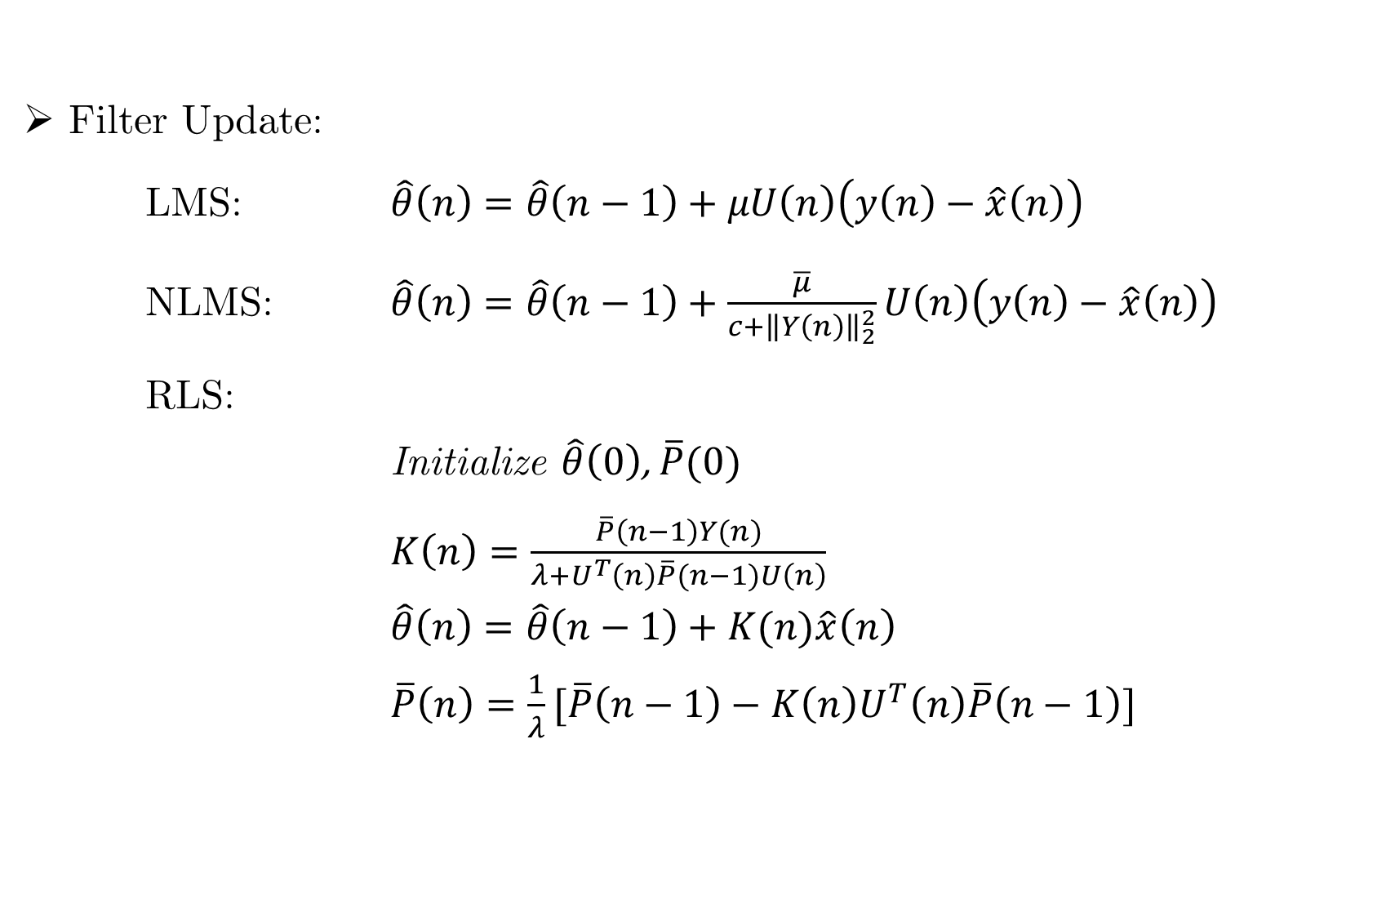
Adaptive Filtering
Filter Update:
LMS: $\hat{θ}\left(n\right)=\hat{θ}\left(n−1\right)+μU\left(n\right)\left(y\left(n\right)−\hat{x}\left(n\right)\right)$
NLMS: $\hat{θ}\left(n\right)=\hat{θ}\left(n−1\right)+\frac{\overline{μ}}{c+{\left\|Y\left(n\right)\right\|}_{2}^{2}}U\left(n\right)\left(y\left(n\right)−\hat{x}\left(n\right)\right)$
RLS:
Initialize $\hat{θ}\left(0\right)$, $\overline{P}(0)$
$K\left(n\right)=\frac{\overline{P}\left(n−1\right)Y(n)}{λ+U^{T}\left(n\right)\overline{P}(n−1)U\left(n\right)}$
$\hat{θ}\left(n\right)=\hat{θ}\left(n−1\right)+K(n)\hat{x}\left(n\right)$
$\overline{P}\left(n\right)=\frac{1}{λ}[\overline{P}\left(n−1\right)−K\left(n\right)U^{T}\left(n\right)\overline{P}\left(n−1\right)]$
end for

Slide 6
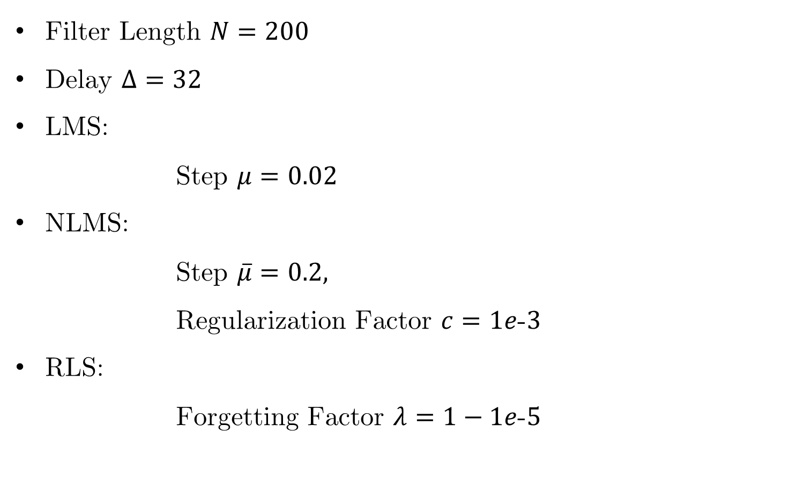
Choice of Parameters
Filter Length $N=200$
Delay $Δ=32$
LMS:
Step $μ=0.02$
NLMS: Step $\overline{μ}=0.2,$
Regularization Factor $c=1e\text{-}3$
RLS:
Forgetting Factor $λ=1−1e\text{-}5$

Slide 7

Results

Slide 8
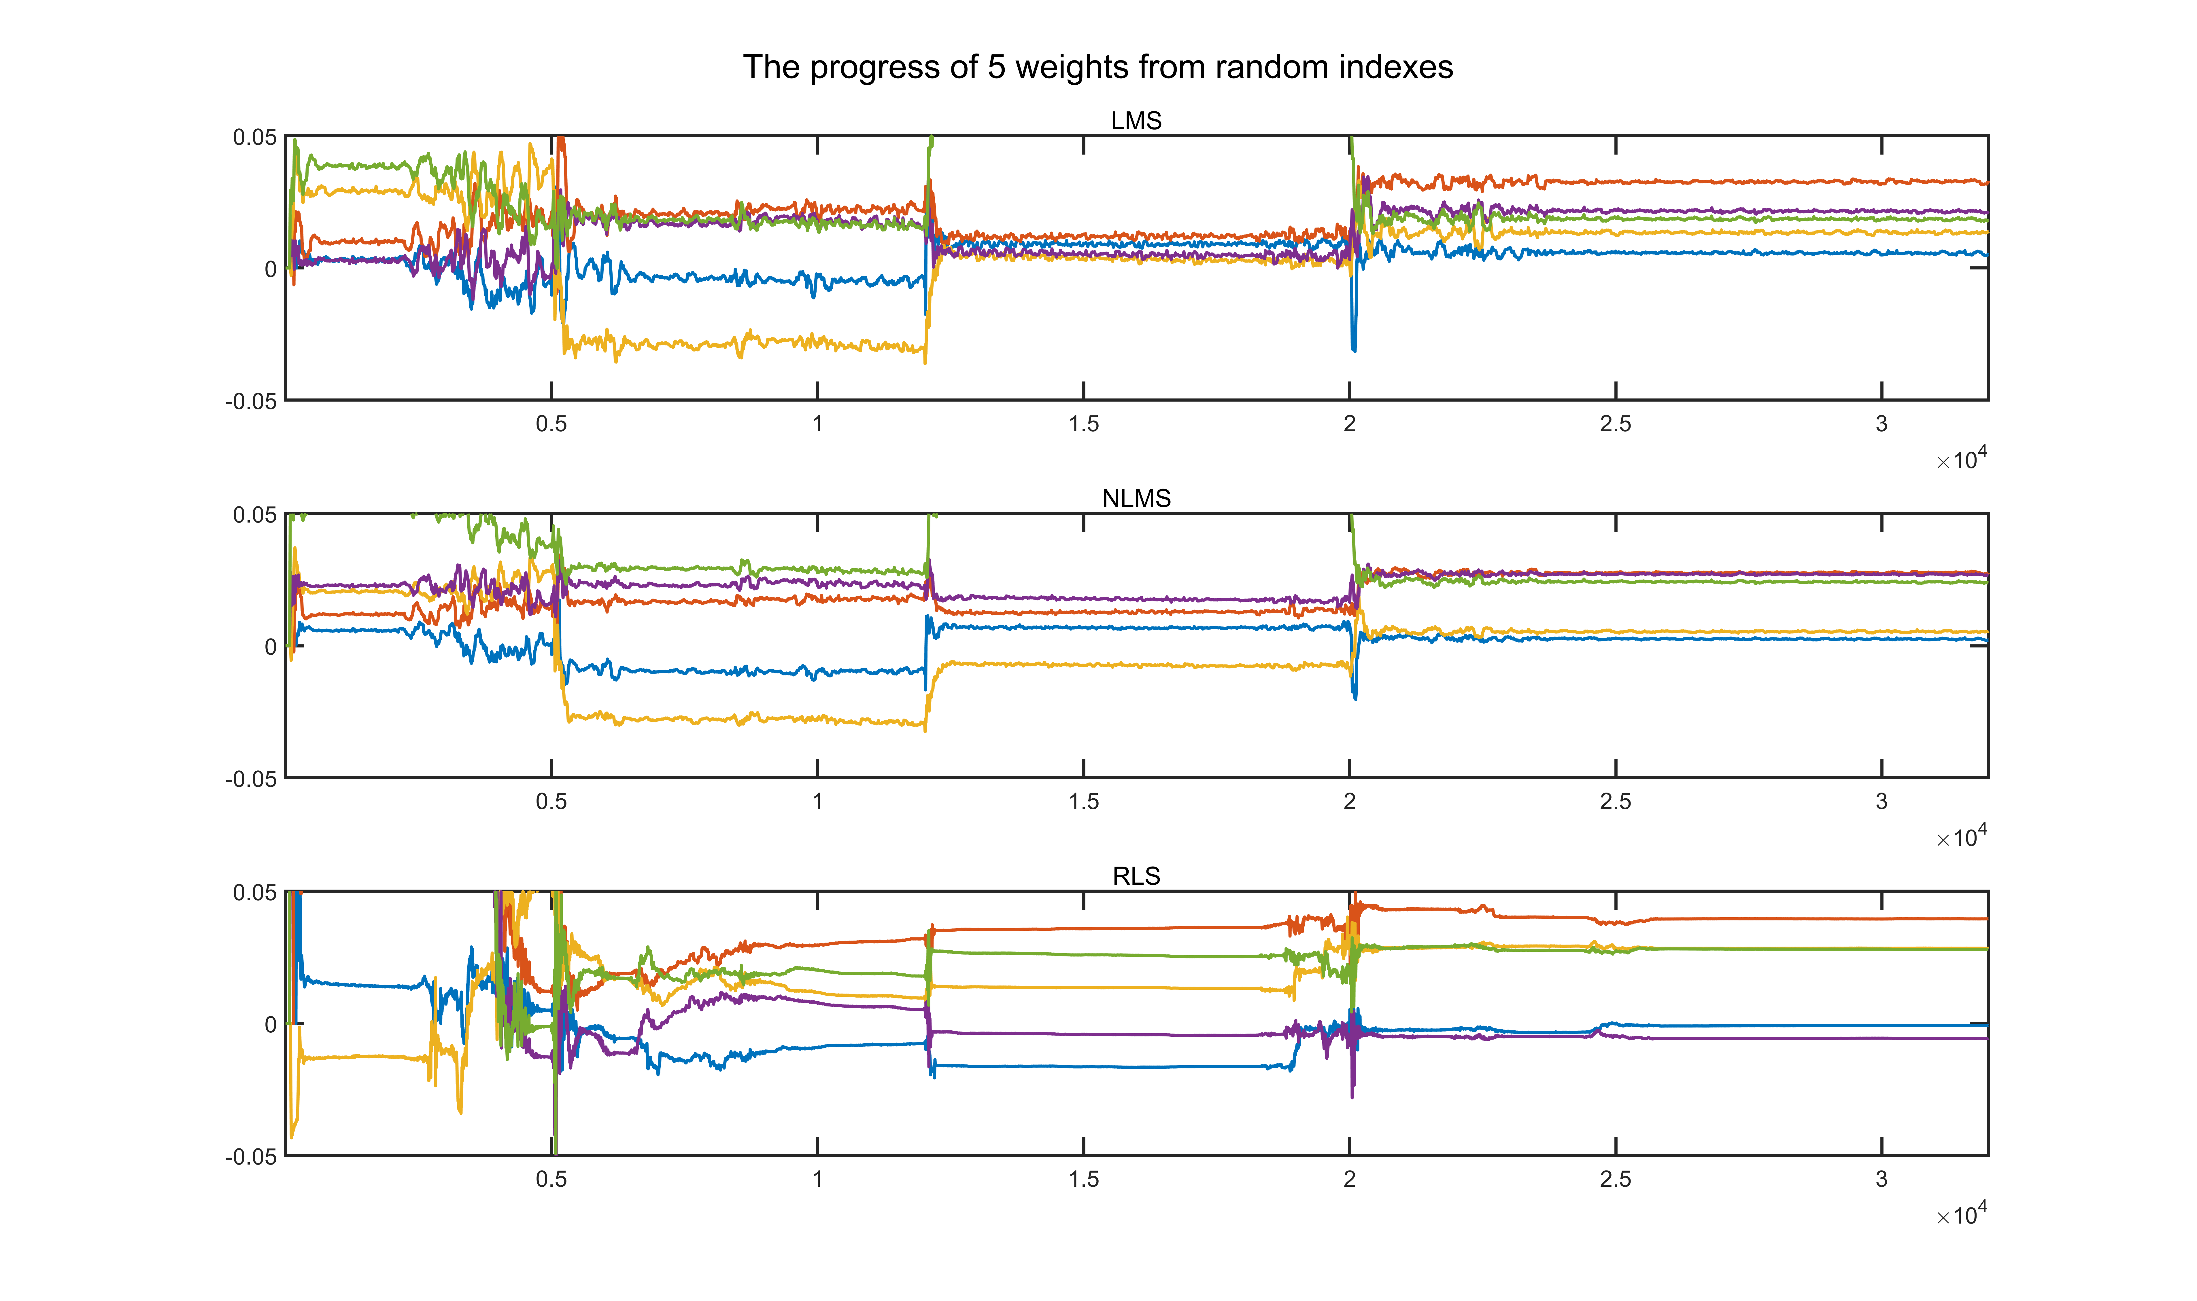
Results

